Slide 1
Analysis of tweets
Snigdha Chigurupati

Slide 2
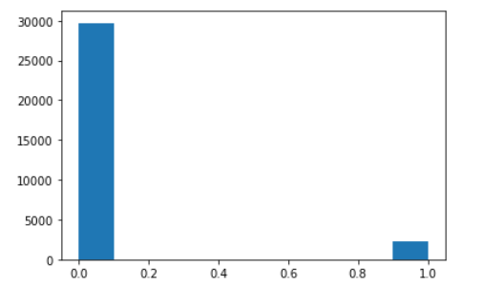
Class 0 – Non hate tweets
Class 1 – Hate tweets
There are a greater number of non-hate / non –offensive tweets that are observed from the data collected.

Slide 3
IMPLEMENTATION / PROJECT FLOW
Data Cleaning
Data Preprocessing
Developing ML model
Model Evaluation

Slide 4
Models recommended
The Recommended models for this dataset are :
LogisticRegression
RandomForestClassfier
SupportVectorMachines

Slide 5
Thank you

